Slide 1

Automotive Technology: A Systems Approach, 8e
Chapter 50: Brake Systems
Rob Thompson and Jack Erjavec, Automotive Technology: A Systems Approach, 8th Edition. © 2025 Cengage. All Rights Reserved. May not be scanned, copied or duplicated, or posted to a publicly accessible website, in whole or in part.

Slide 2
Chapter Objectives (1 of 2)
50.01 Explain the basic principles of braking, including kinetic and static friction, friction materials, application pressure, and heat dissipation.
50.02 Describe the components of a hydraulic brake system and their operation, including brake lines and hoses, master cylinders, system control valves, and safety switches.
50.03 Describe the operation of drum and disc brakes.

Slide 3
Chapter Objectives (2 of 2)
50.04 Perform both manual and pressure bleeding of the hydraulic system.
50.05 Inspect and service hydraulic system components.
50.06 Describe the operation and components of power-assist braking units.

Slide 4
Friction (1 of 2)
50-01 Explain the basic principles of braking, including kinetic and static friction, friction materials, application pressure, and heat dissipation.
Kinetic Friction
  Is caused by rotating brake parts
  Changes kinetic energy into thermal energy (heat)
Static Friction
  Holds the car in place when stopped

Slide 5
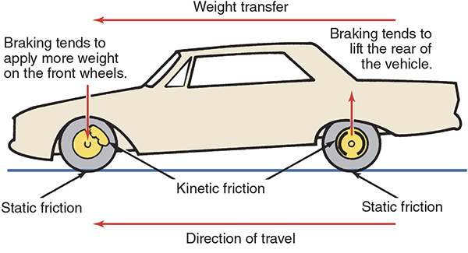
Friction (2 of 2)

Slide 6
Factors Governing Braking
Four basic factors determine braking power.
Generation of friction
  Pressure
  Coefficient of friction
  Friction contact surface
Result of Friction
  Heat dissipation
Weight transfer also affects braking

Slide 7
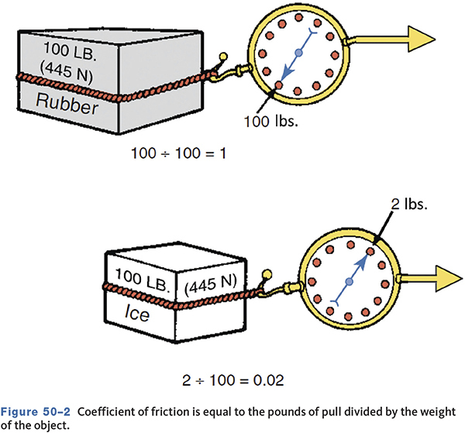
Coefficient of Friction

Slide 8
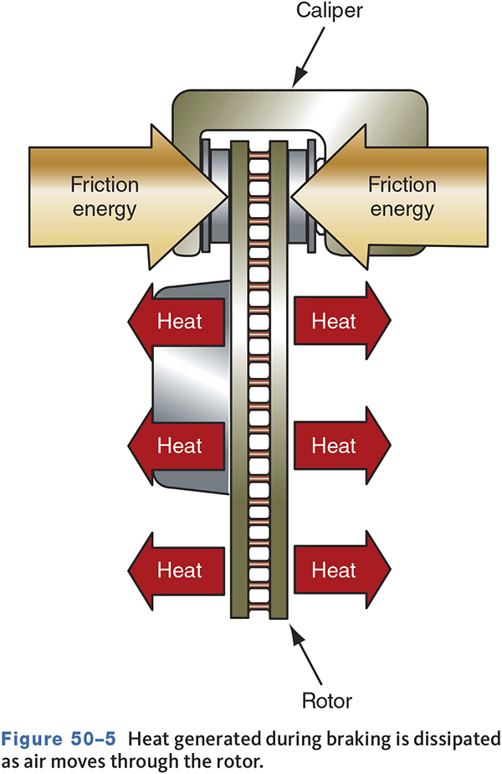
Heat Dissipation
Heat must be conducted away from pads/rotor or shoes and drum.
Inadequate heat dissipation can cause brake fade.

Slide 9
Brake Lining Friction Materials
Non-asbestos organic (non-metallic)
  Friction materials, graphite, nut shells, fillers
Fully metallic
  Work poorly until fully warmed
Semi-metallic
Synthetic
Ceramic
Carbon-metallic/ceramic

Slide 10
Low-Copper Compliance Pads
Required by Washington state and California
Three levels
  Level A pads comply with requirements for cadmium, chromium, lead, mercury, and asbestos.
  Level B pads meet Level A requirements, and copper content must be reduced to less than 5 percent of the pad material by 2021.
  Level N pads will have less than 0.5 percent total copper by 2025.

Slide 11
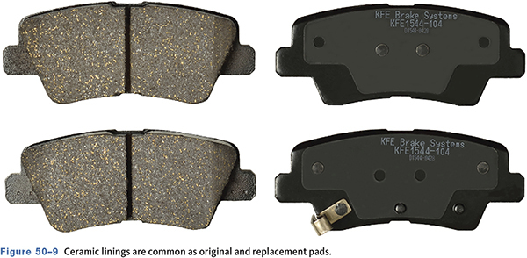
Pad Linings

Slide 12
Principles of Hydraulic Brake Systems
Uses fluid to transfer pressure
Pressure applied to fluid in a closed system is consistent.
Force can be increased by changing piston sizes.
Output piston travel can be increased by using a smaller piston.

Slide 13
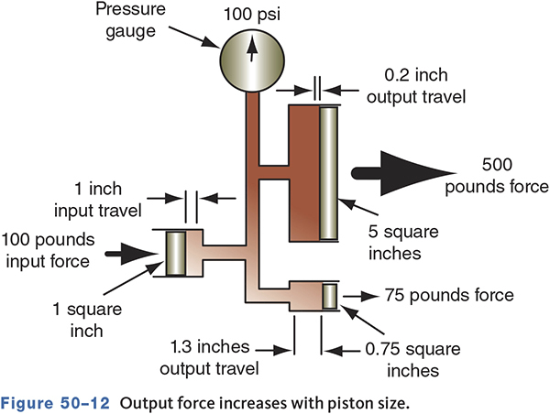
Output Force

Slide 14
Knowledge Check (1 of 3)
In a brake hydraulic system,
Technician A says increasing the size of the output piston will result in an increase in application force.
Technician B says increasing the size of the output piston will result in an increase in piston travel. Who is correct?

Slide 15
Knowledge Check Answer (1 of 3)
In a brake hydraulic system,
Technician A says increasing the size of the output piston will result in an increase in application force.
Technician B says increasing the size of the output piston will result in an increase in piston travel. Who is correct?
Answer: Technician A only

Slide 16
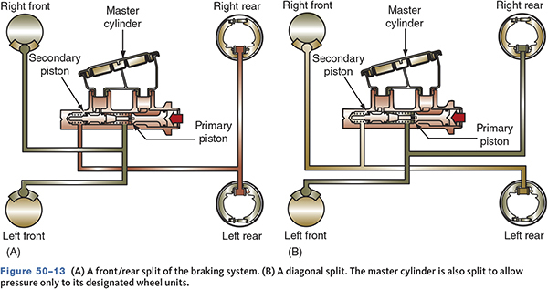
Dual Braking Systems
Diagonally split allows more even braking in the event one circuit fails.

Slide 17
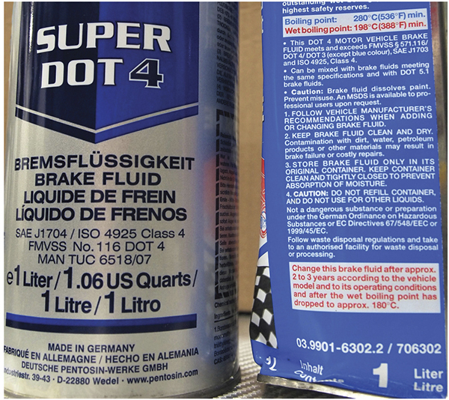
Brake Fluid (1 of 2)
Special blended for a variety of functions
  Flow freely at very high and very low temperatures
  Lubricate the parts of the hydraulic system
  Must resist evaporation

Slide 18
Brake Fluid (2 of 2)
Absorbs moisture (hygroscopic)
Can absorb enough moisture in two years to lower boiling point to a dangerous level
Identified by SAE and DOT for blend and performance characteristics
Use only the approved fluids in the brake system

Slide 19
DOT Ratings
DOT 3 has a minimum dry boiling point of 401°F (205°C) and a minimum wet boiling point of 284°F (140°C).
DOT 4 has a dry boiling point of 446°F (230°C) and a wet boiling point of 311°F (155°C).
DOT 5 is a silicone-based fluid and is purple in color and is NOT compatible with antilock brake systems or with DOT 3 or DOT 4 fluids.
DOT 5.1 has a dry boiling point of 500°F (260°C) and a wet boiling point of 356°F (180°C).

Slide 20
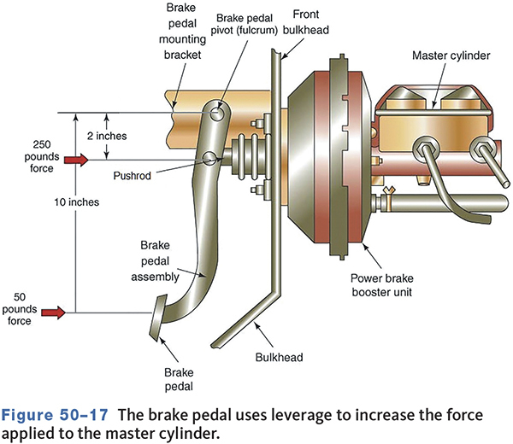
Brake Pedal
50-02 Describe the components of a hydraulic brake system and their operation, including brake lines and hoses, master cylinders, system control valves, and safety switches.

Slide 21
Master Cylinder
Transmits pressure to the wheel brakes
Changes mechanical pressure into hydraulic force
Uses hydraulics to increase pedal force
Since 1967, all vehicles have used a two-piston split hydraulic system master cylinder.

Slide 22
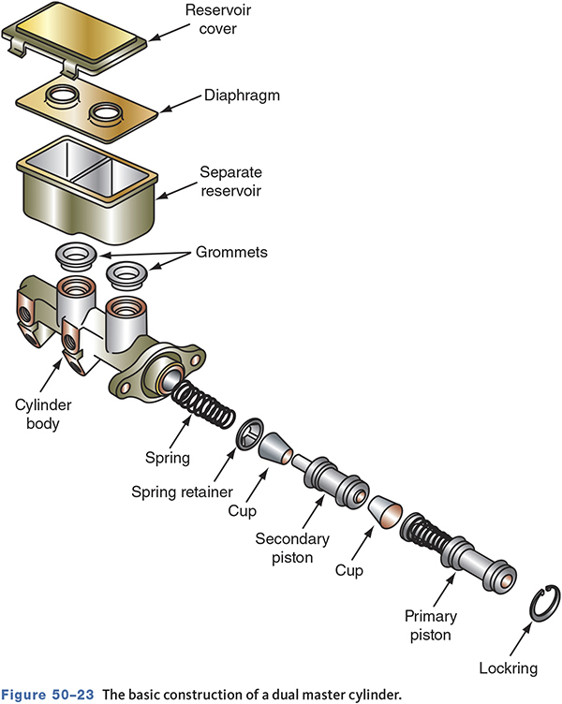
Master Cylinder Components

Slide 23
Master Cylinder Operation
The master cylinder pushrod is connected to a piston.
Hydraulic fluid is in front of the piston.
When the pedal is pressed, the piston is pushed forward.
The fluid transmits force throughout the system.

Slide 24
Fast-Fill and Quick-Take-Up Master Cylinders
Used to quickly take up the slack in low drag calipers
Provides a large volume of fluid on the first stroke of the brake pedal
Has a larger diameter bore primary piston

Slide 25
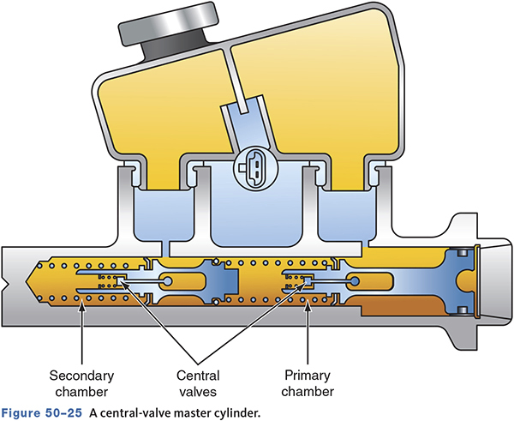
Central-Valve Master Cylinders
Used on some ABS equipped systems
Prevents seal damage and pedal pulsation during ABS braking

Slide 26
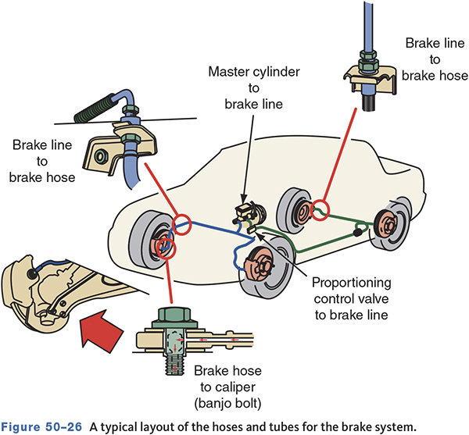
Hydraulic Tubes and Hoses

Slide 27
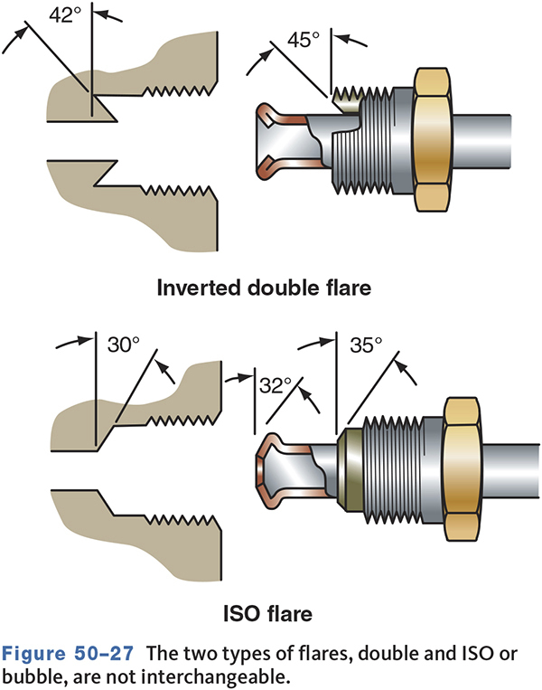
Fitting Flares

Slide 28
Brake System Valves
Metering Valve
  Delays application of front disc brakes until pressure builds to rear drum brakes
Proportioning Valve
  Applies more hydraulic pressure to the disc brakes to balance braking
Combination Valve
  Combines several functions in one valve

Slide 29
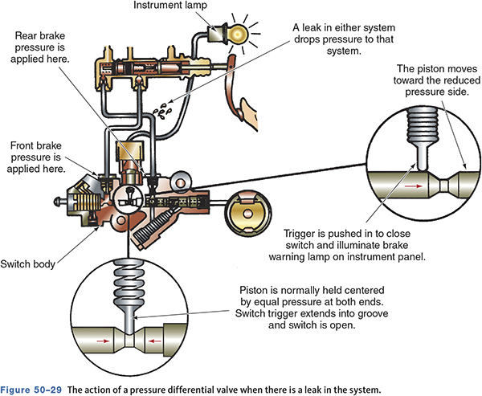
Pressure Differential Valve
Operates warning light if pressure is lost in either hydraulic circuit
If pressure is lost, the valve will move to the low pressure.

Slide 30
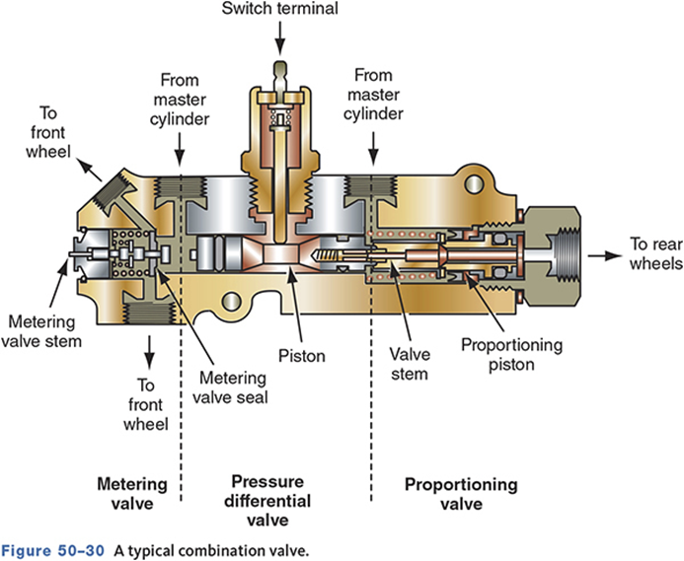
Combination Valve

Slide 31
Knowledge Check (2 of 3)
Technician A says proportioning valves are used to control front disc brake application. Technician B says metering valves are used to prevent rear drum brake lockup under heavy braking. Who is correct?

Slide 32
Knowledge Check Answer (2 of 3)
Technician A says proportioning valves are used to control front disc brake application. Technician B says metering valves are used to prevent rear drum brake lockup under heavy braking. Who is correct?
Answer: Neither Technicians A nor B
Notes:
N

Slide 33
Warning Lights
Failure warning lamp switch
  Operated by the pressure differential valve
Master cylinder fluid level switch
  Illuminates warning light when fluid level is low
Parking brake switch
  Warns driver that the parking brake is engaged

Slide 34
Stop Lamps
Stop lamps are part of rear tail lamp assemblies and the center high-mounted stop lamp (CHMSL).
Usually, the stop lamp switch is mounted with the brake pedal.
Brake lamp switch output is often used for cruise control and TCC disengagement.

Slide 35
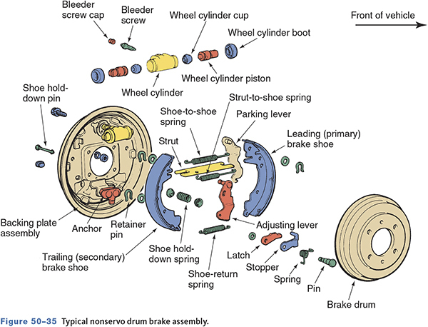
Drum Brakes
50-03 Describe the operation of drum and disc brakes.
Consists of shoes mounted to a backing plate
Hydraulic pressure forces shoes apart against inside of the brake drum.

Slide 36
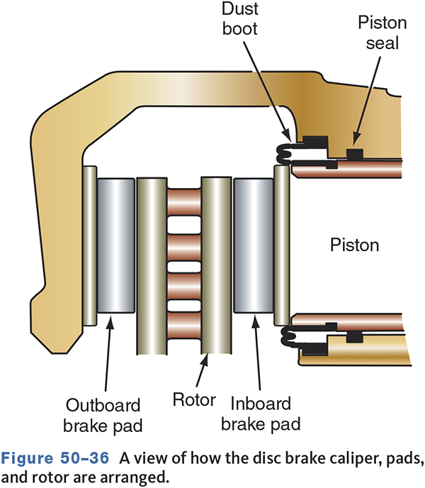
Disc Brakes
The pads are squeezed against the brake rotor.
Hydraulic pressure forces the caliper piston(s) outward.

Slide 37
Brake Fluid Inspection
Remove the cover and check the gasket
Check the fluid in the reservoir
  Do not overfill
Check the fluid for contamination
Test strips can check fluid condition.
Special testers can check boiling point.
Check the master cylinder for signs of leaks

Slide 38
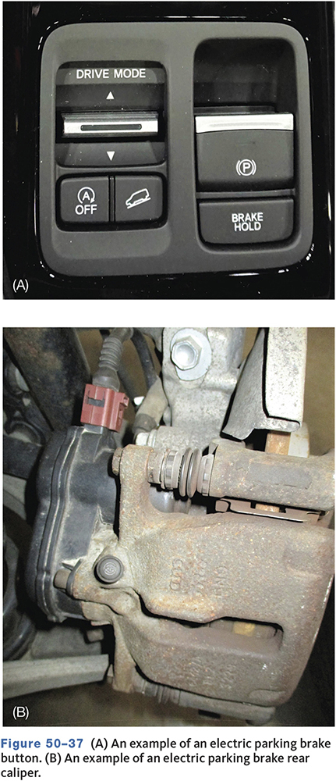
Electric Parking Brakes
Provide some control during emergency braking.
Help stop the car if the hydraulic system fails.
Automatically release the parking brakes when the throttle is opened.

Slide 39
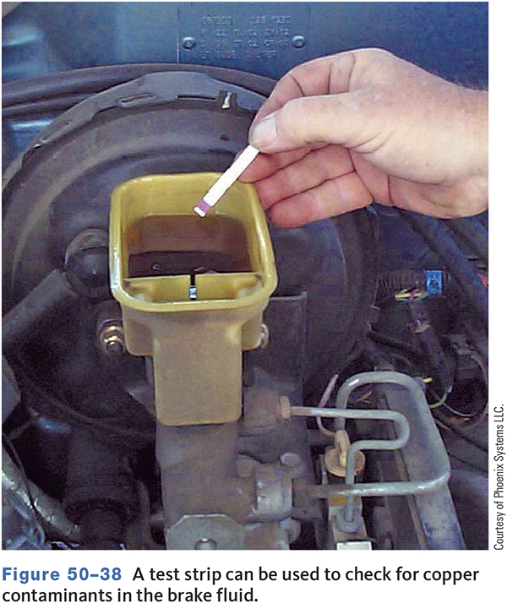
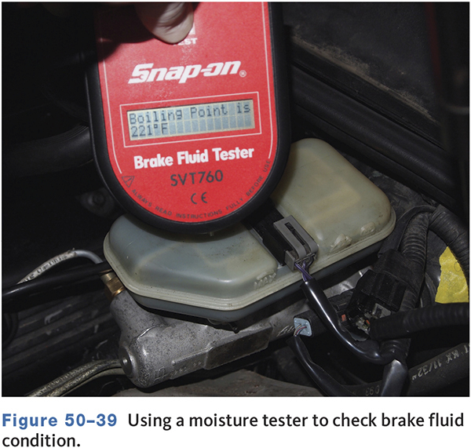
Moisture Testing

Slide 40
Master Cylinder Inspection
50-05 Inspect and service hydraulic system components.
Check housing for cracks or damage.
Leaks can be internal or external.
Pump brake pedal and hold down, the pedal should not drop.
  If the pedal drops and there are no external leaks, suspect the fluid is bypassing the seals inside the master cylinder.

Slide 41
Air-Entrapment Test
Remove master cylinder cover and fill fluid to the proper level.
Place cover on top but do not secure.
Have an assistant pump the pedal 10 to 20 times rapidly and hold.
Remove the cover and release the pedal.
Watch for a squirt of fluid.

Slide 42
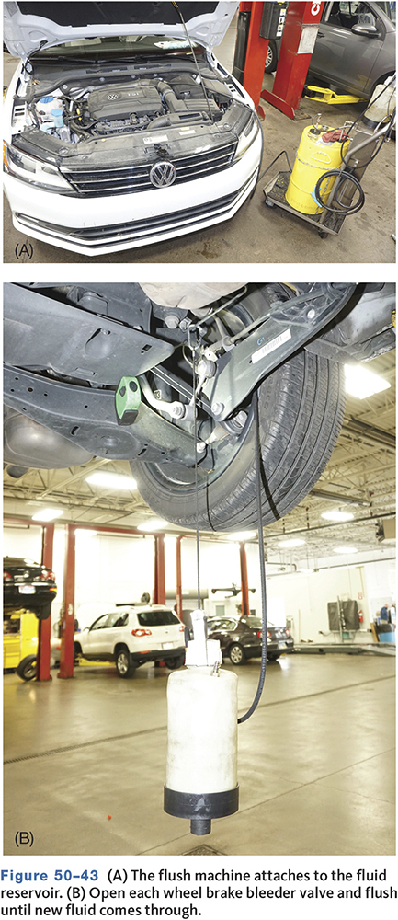
System Flushing
Many manufacturers specify periodic brake fluid flushing.
Open each bleeder and pump fluid out until fresh new fluid appears.
Flushing can remove sludge and moisture.

Slide 43
Hydraulic System Bleeding
50-04 Perform both manual and pressure bleeding of the hydraulic system.
Any air in the system can be compressed.
This decreases the amount of force that can be transmitted by the fluid.
Bleeding removes the air trapped in the system.
Two types of bleeding are common
  Manual bleeding
  Pressure bleeding

Slide 44
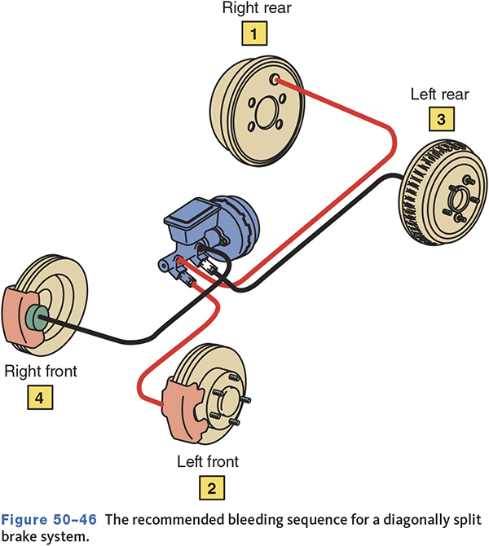
Typical Bleeding Sequence

Slide 45
Power Brakes
50-06 Describe the operation and components of power-assist braking units.
Standard brakes with a power assist unit located between the brake pedal and master cylinder
Two types of power assist used
  Vacuum assist
  Hydraulic assist

Slide 46
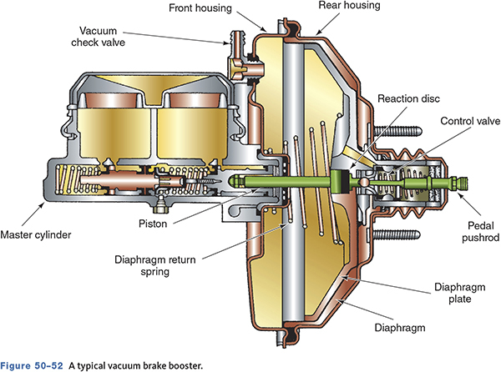
Vacuum Assist
Apply assist by opposing engine vacuum to atmospheric pressure.
Modern systems are vacuum suspended.
Boosters may be single or dual diaphragm.
When the brake is applied, atmospheric pressure is allowed to enter the rear chamber.

Slide 47
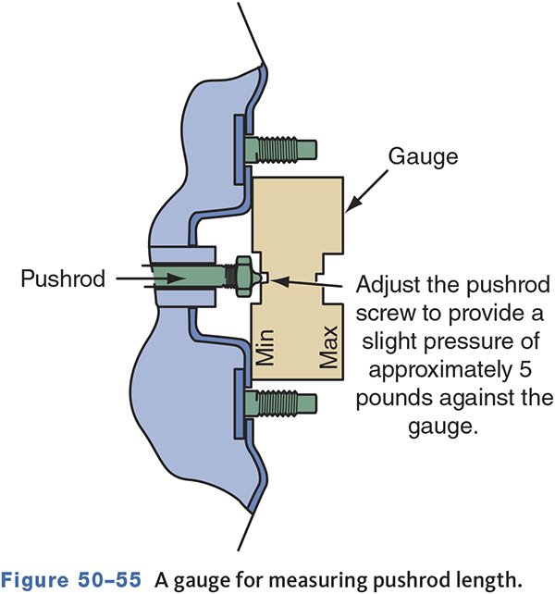
Pushrod Adjustment
Adjustment is necessary to prevent excessive travel or dragging.
Is usually only checked after replacement
An air test checks by pressurizing the master cylinder.

Slide 48
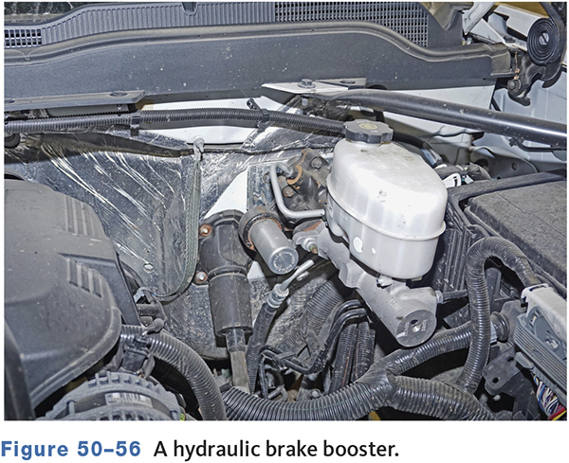
Hydraulic Brake Boosters
Fluid pressure supplied by the power steering system
Developed because of decreases in engine size
Found on diesel engines and engines with low vacuum

Slide 49
Knowledge Check (3 of 3)
True or False:
In a vehicle equipped with hydraulic brake assist, a fault in the power steering system could affect power brake assist.

Slide 50
Knowledge Check Answer (3 of 3)
True or False:
In a vehicle equipped with hydraulic brake assist, a fault in the power steering system could affect power brake assist.
Answer: True
Notes:
True

Slide 51
Chapter Reflection
What concept from this chapter challenged you the most? Describe what made the concept difficult for you and the steps you took to improve your understanding.
How could you help another learner who was struggling with the same concept?
Use 100–150 words in your answer.

